Slide 1
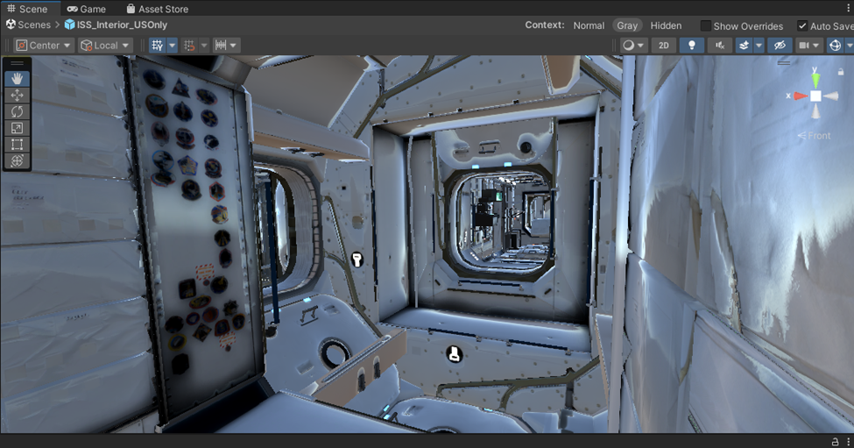
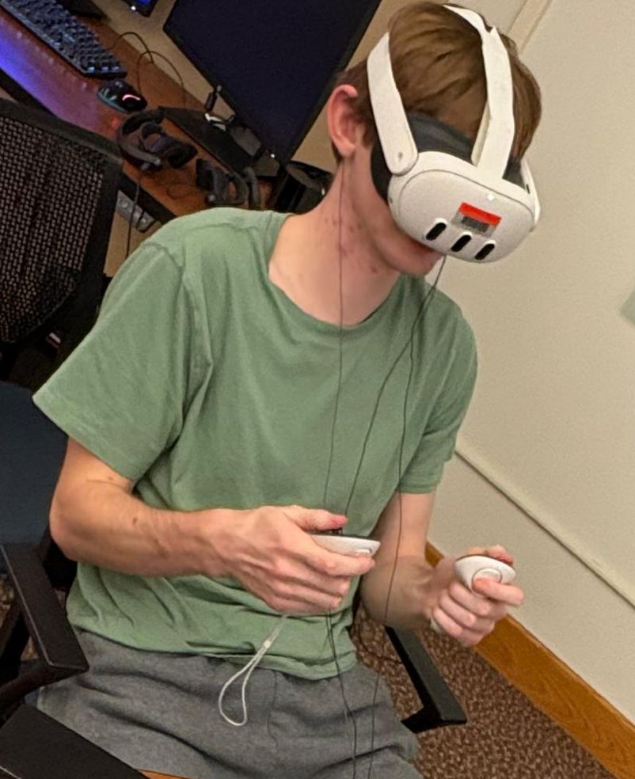
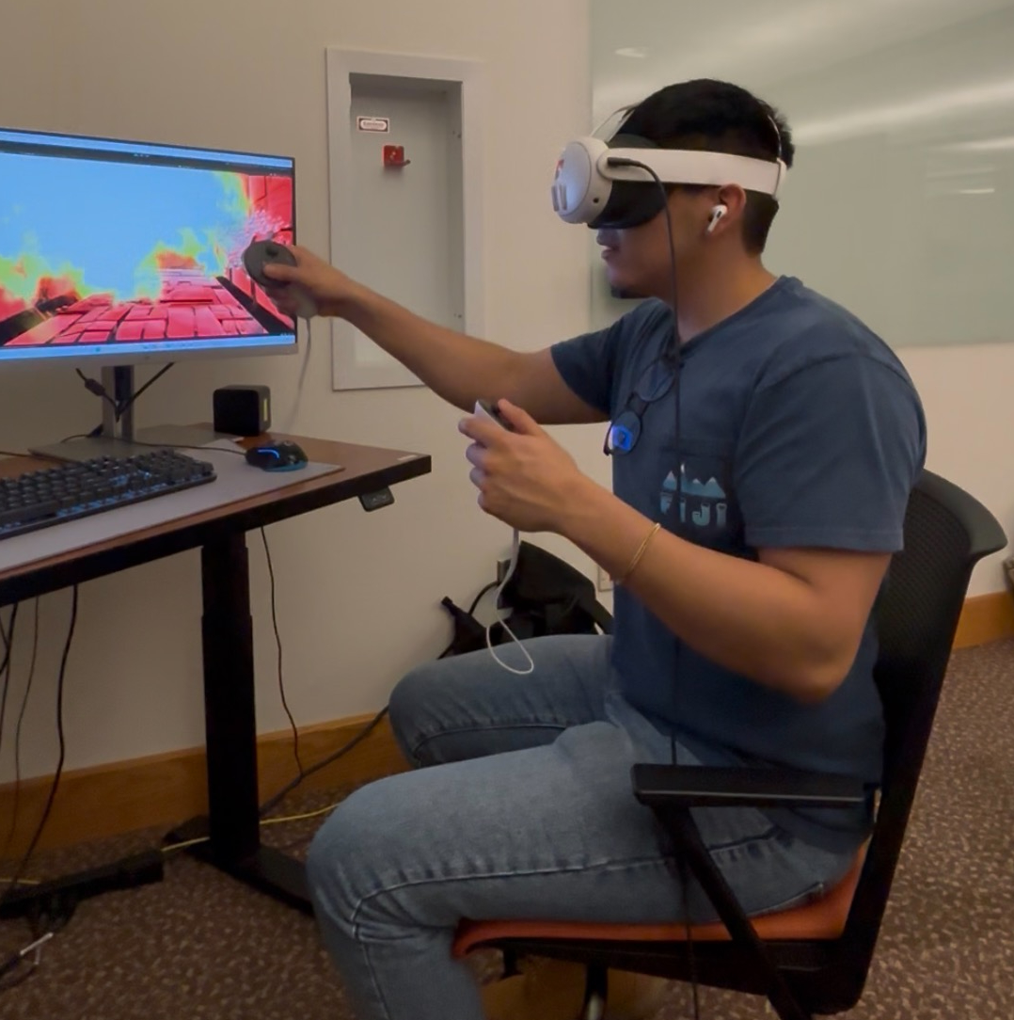
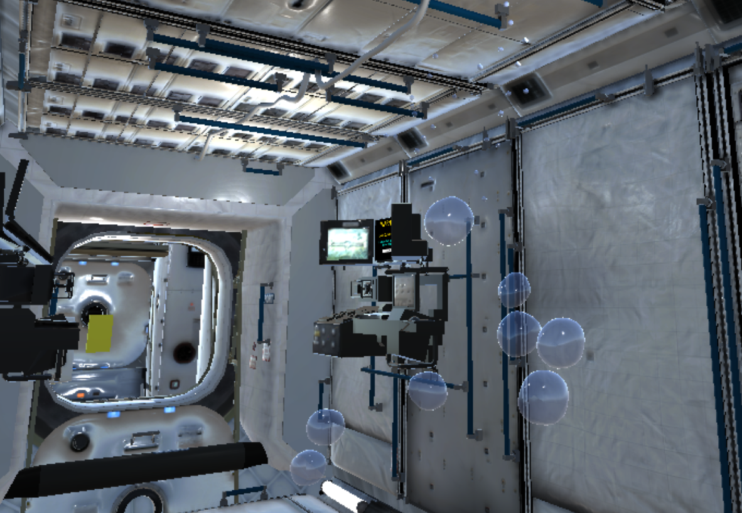
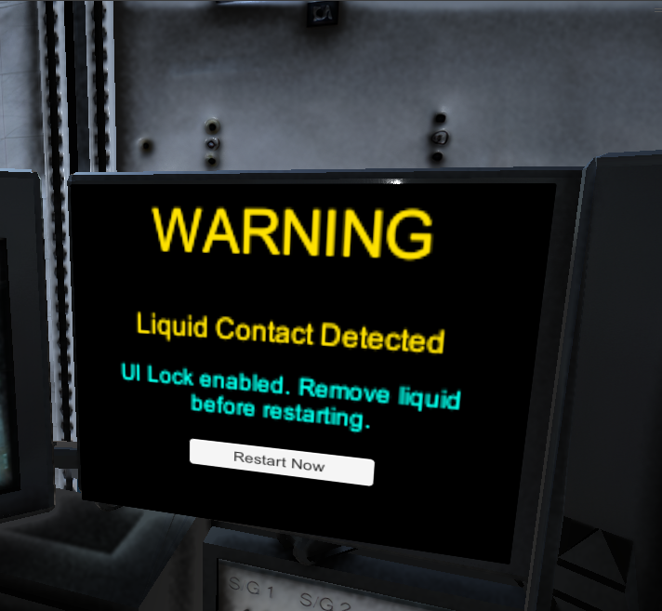
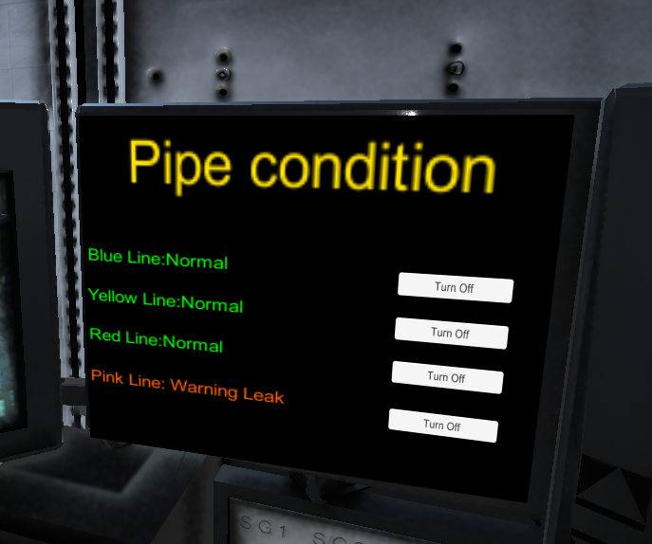
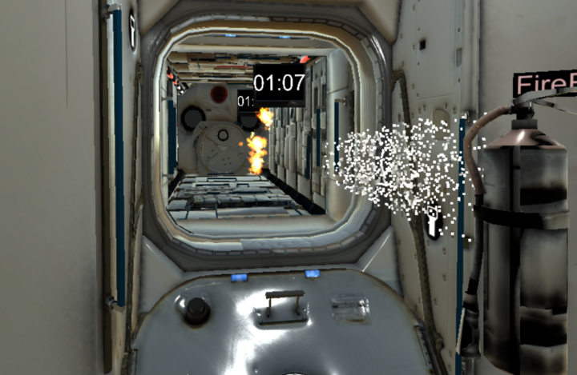
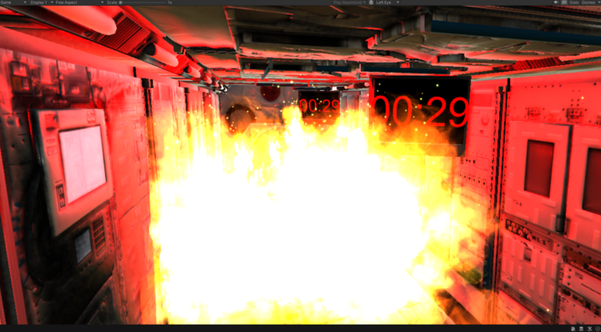
Closed-Loop VR Biofeedback for Stress Reduction Space Scenario
Aathreya Doddi, Casey Keymolen, Henry Hancock, mentored by Aagam Jain and Dr. Elle Wroblewski
Department of Aerospace Engineering, Grainger College of Engineering, University of Illinois Urbana-Champaign
INTRODUCTION
Long-duration space missions expose astronauts to confinement, alarms, time pressure, and high-consequence decision-making. These stressors can negatively affect both task performance and mental well-being, especially during emergency procedures.
Since real spaceflight emergencies cannot be safely or repeatedly recreated for testing, virtual reality offers a controlled and immersive way to simulate stressful operational conditions. This project explores a closed-loop VR biofeedback framework for astronaut-inspired emergency scenarios, where stress-related changes can eventually be monitored and responded to with an in-simulation countermeasure.
METHODOLGY
Scenario Design
The VR prototype was developed in Unity for Meta Quest hardware using an ISS-like interior environment. The current emergency scenarios involve a water leak, re-entry, and a fire event in which the participant must identify the hazard, acquire the necessary tools, and respond under time pressure.
The stress-detection framework is organized into three phases:
1. Baseline Phase
The participant becomes familiar with the environment under relatively calm conditions to establish reference behaviour.
2. Stress-Induction Phase
The participant performs time-constrained emergency tasks under alarms, urgency, visible fire growth, and multi-step objectives.
3. Countermeasure Phase
If stress-related indicators exceed a threshold, the system is designed to deliver guided breathing and calming prompts.
At the current stage, the primary indicators are behavioural rather than physiological. These include:
• Task completion time
• Delayed reaction to objectives
• Repeated failed interactions
Prototype Results
The most meaningful results at this stage are feasibility and implementation results rather than full experimental findings.
Current prototype progress includes:
• Development of a Unity-based ISS emergency-response simulation.
• Integration of fire and handheld fire-extinguisher assets
• timed hazard escalation to increase urgency.
• event sequencing that supports baseline, stress, and intervention phases.
• A structured emergency task that transitions from active response to failure-state escalation.
These results show that a space-relevant emergency scenario can be created in VR and used as a foundation for future closed-loop stress monitoring and intervention research.
• Missed procedural steps
• Retry or assistance events
Objective
The objective of this project is to develop a feasibility-level closed-loop VR stress detection and intervention prototype for astronaut-inspired emergency scenarios.
The platform is designed to:
• Expose users to a controlled stress-inducing task environment
• Monitor performance- and stress-related indicators during task execution
• Trigger an in-simulation calming intervention when stress is detected.
The current prototype focuses on a fire emergency scenario in an ISS-like environment and lays the groundwork for future physiological sensor integration.
CONCLUSIONS
This project demonstrates early progress toward a closed-loop VR platform for astronaut-inspired stress detection and countermeasure delivery.
The current contribution is a technically grounded prototype architecture centered on:
• scenario development.
• interaction reliability.
• behavioral logging.
• escalation-based stress induction.
Future work will focus on improving immersion and interaction consistency, expanding the fire scenario into a more validated task sequence, and integrating physiological sensors with a live vitals display.
The Interior of the ISS model used
Team members during self-testing
Tools/Software
Hardware and software technologies used for this project:
• Unity
• Meta Quest 3
• XR interaction and custom scripting
• ISS-inspired interior assets
• Grainger Idea Lab computer resources
• Planned physiological sensor integration
• Planned live vitals display pipeline
Simulations were developed on the Unity software and subsequently tested using the Meta Quest 3 headset.
Water leak simulation in progress
UI used to mitigate water leak and pipe flow
ACKNOWLEDGEMENTS
We would like to express our sincere gratitude to Aagam Jain for his guidance and support throughout this project. We also acknowledge the Department of Aerospace Engineering and the Grainger College of Engineering for providing the academic environment and resources necessary for this work. Additional thanks go to the Grainger Idea Lab for supporting innovation and development, and to Dr. Elle Wroblewski for her mentorship and contributions to our research efforts.
Active fire-response state with handheld extinguisher interaction.
Escalated fire-spread state used to increase urgency and visual stress.

